Slide 1
Practical Project Demo
Creating Dynamic Rich-Data ASP.NET Web Application: Step-by-Step Live Demo
Svetlin Nakov
Telerik Corporation
www.telerik.com

Slide 2
Table of Contents
Sample practical project
Creating a simple blog system
Steps:
Prototyping of the user interface
Design of the database
Data access layer based on LINQ-to-SQL
User interface based on ASP.NET Web Forms
Testing the system

Slide 3
Assignment – Blog System
Create a simple blog system:
Read blog posts (messages) and comments
Login / logout
Post new message (for logged users)
Post comments for a message
Each blog message (post) has:
Author, date, subject, body
Comments have
Author date and body

Slide 4
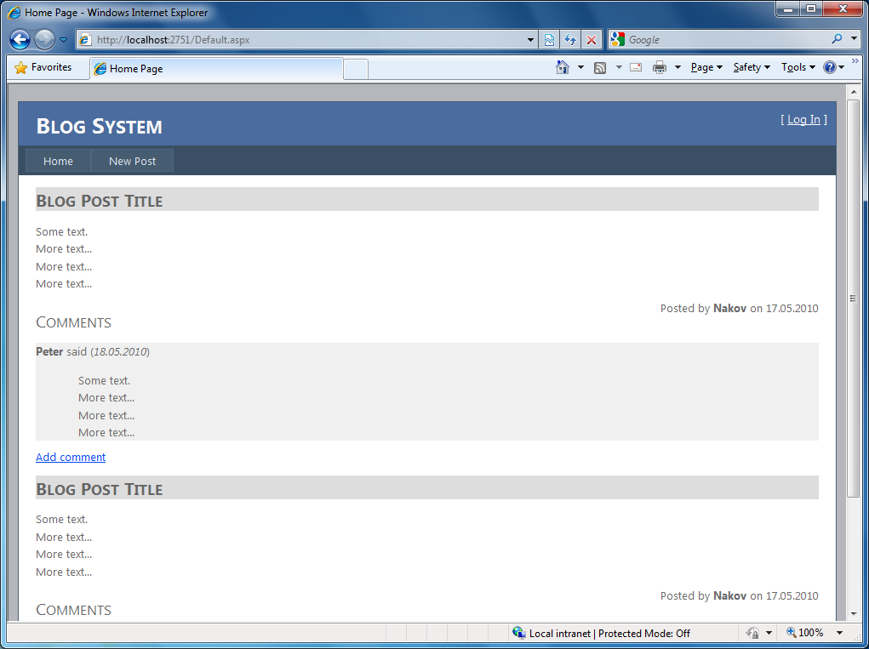
Step 1: Prototyping the UI (1)

Slide 5
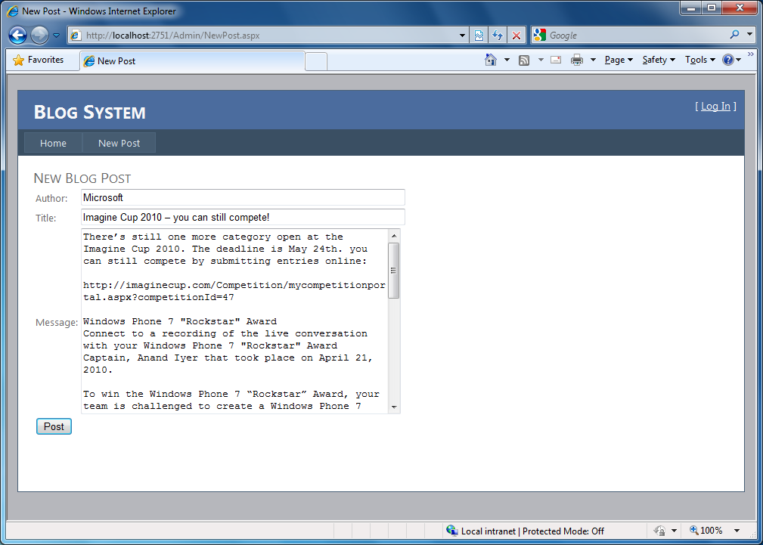
Step 1: Prototyping the UI (2)

Slide 6
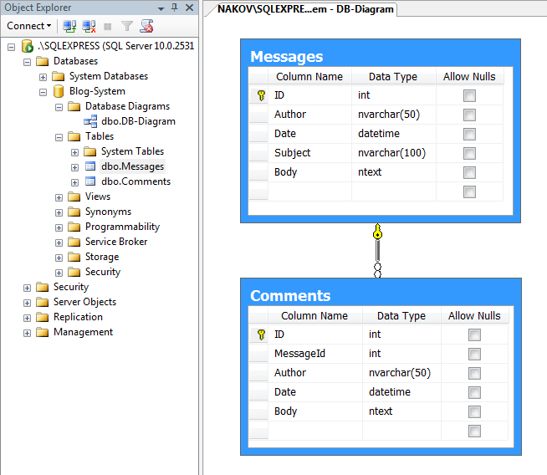
Design the Database

Slide 7
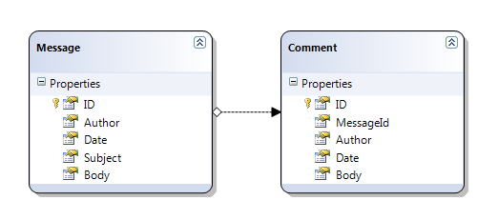
Create the Data Access Layer: based on LINQ-to-SQL

Slide 8
ASP.NET Web Forms UI
…

Slide 9
Testing the System
…

Slide 10
Practical Project Demo

